Slide 1
Input & Output
Console Application

Slide 2
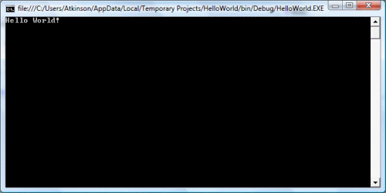
The Console
an operating system window
where users interact with the operating system or a text-based console application by entering text input through the computer keyboard
and reading text output from the computer terminal.
Note:
Window’s console is called the command prompt window & accepts MS-DOS commands.

Slide 3
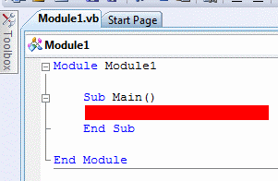
Creating A Console Application
1. Start by launching Visual Basic Express from the Start Menu (within the VM).
2. Click on File, New Project and choose Console Application in the dialog box.
3. Choose an appropriate name for your first program and click OK.
4. A window will pop up showing the following code.
Any code that we write in our program will go in the space coloured red.

Slide 4
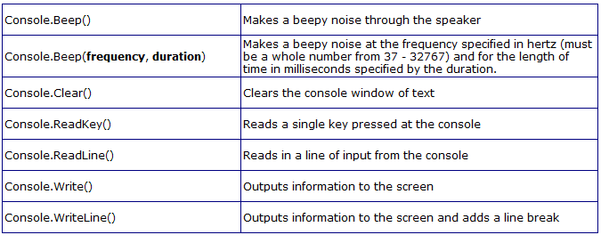
Console Methods

Slide 5
Concept of a data type
Data Types

Slide 6

Data Types (generic)
Integer: +ve / -ve whole number; -2, 1, 0
Real/float: number that has a fractional or decimal part; 3.5, 3⅓
Text/String: combination of characters, either text and/or numbers; Name ← Frank, Telephone No.
Boolean: data with only 2 possible values; yes/no, black/blue
Character: single character, either a letter, number or symbol

Slide 7
6. Date/time: 30.04.2014 or 12:30
7. Records: a collection of related data items, where all items have different data types; record called Book, will store title, author, name, ISBN.
Book = Record
Title, Author As Text * 50
ISBN As Text * 13
PublicationDate As Date
8. Arrays: collection of data items of same type; Student(2) = Ali, George, Sonia

Slide 8
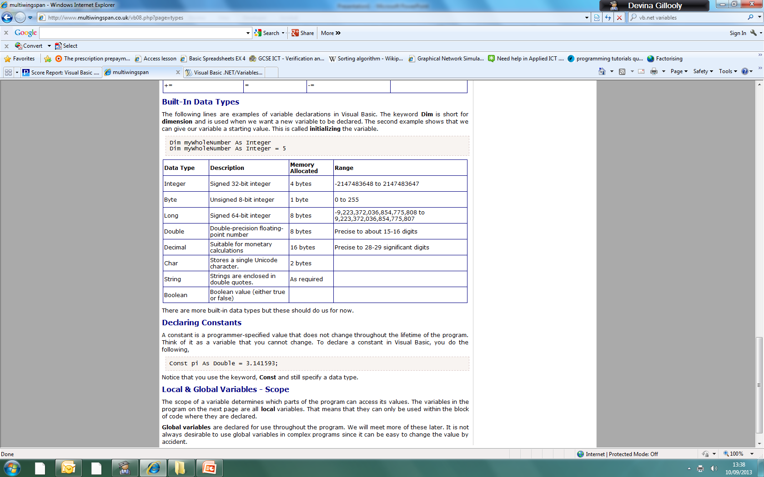
Data Types (built-in)
* There are more data types – use MSDN when you come across them

Slide 9
Class Task
Resource: ZigZag handout, pages 4-16 (stop before 2.8)
VB terminology & IDE
Input and Output
Basic VB Console Application
Input boxes & Message boxes
Extension: 2.7 Data Types (ZigZag, pgs 14-16)
Recap questions (ppt)

Slide 10
Plenary Questions - Console
The two statements below are used for outputting information to the console. Explain the difference.
Why is it important to have Console.ReadLine() before the end of the program?
Console.WriteLine() Console.Write()

Slide 11
Plenary Questions – Data Type
State True or False:
Boolean is a data type that has 2 values only.
Integer is a data type that can hold signed numbers.
Character is the same as String.
To store a postal address we should use a variable of String data type.
To store a telephone number we should use a variable of Integer data type.

